Slide 1

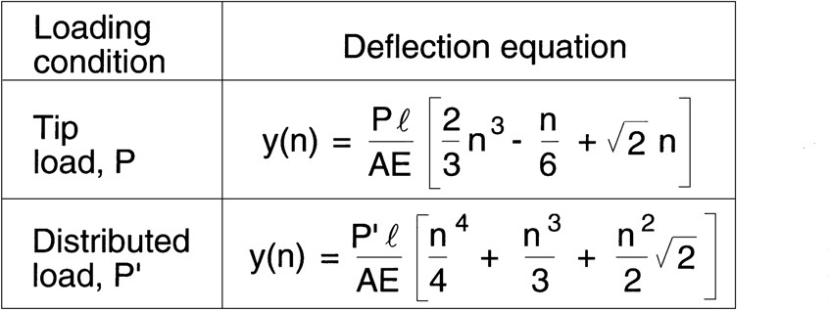
Introduction to Lattice Truss Beams
Truss Mechanics
LATTOGLE TM
Distributed load, P’
P/2
P/2
Tip (End) load, P
One truss unit, n

